Slide 1
Chapter 5 Monte Carlo Methods
Intro to Reinforcement Learning
By Richard Sutton

Slide 2
New method: Monte Carlo method
Do not assume complete knowledge of environment
Only need experience
Can use simulated experience
Average sample returns
Use General Policy Iteration (GPI)
Prediction: compute value functions
Policy Improvement: improve policy from value functions
Control: discover optimal policy

Slide 3




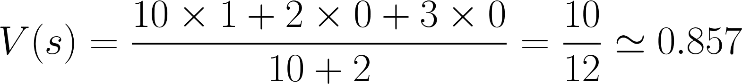
Monte Carlo Prediction:
Estimate from sample return
Converges as more returns are observed
Return 1 observed 10 times
Return 0 observed 2 times
Return -1 observed 0 times

Slide 4
First-visit MC vs. Every-visit MC
s1
First-visit
s2
s3
Average of returns following first visits to states
Studied widely
Primary focus for this chapter
Every-visit
Average returns following all visits to states
Extended naturally to function approximation (Ch. 9) and eligibility traces (Ch. 12)
Sample Trajectory:
s1
s2
s3
s2
s3

Slide 5
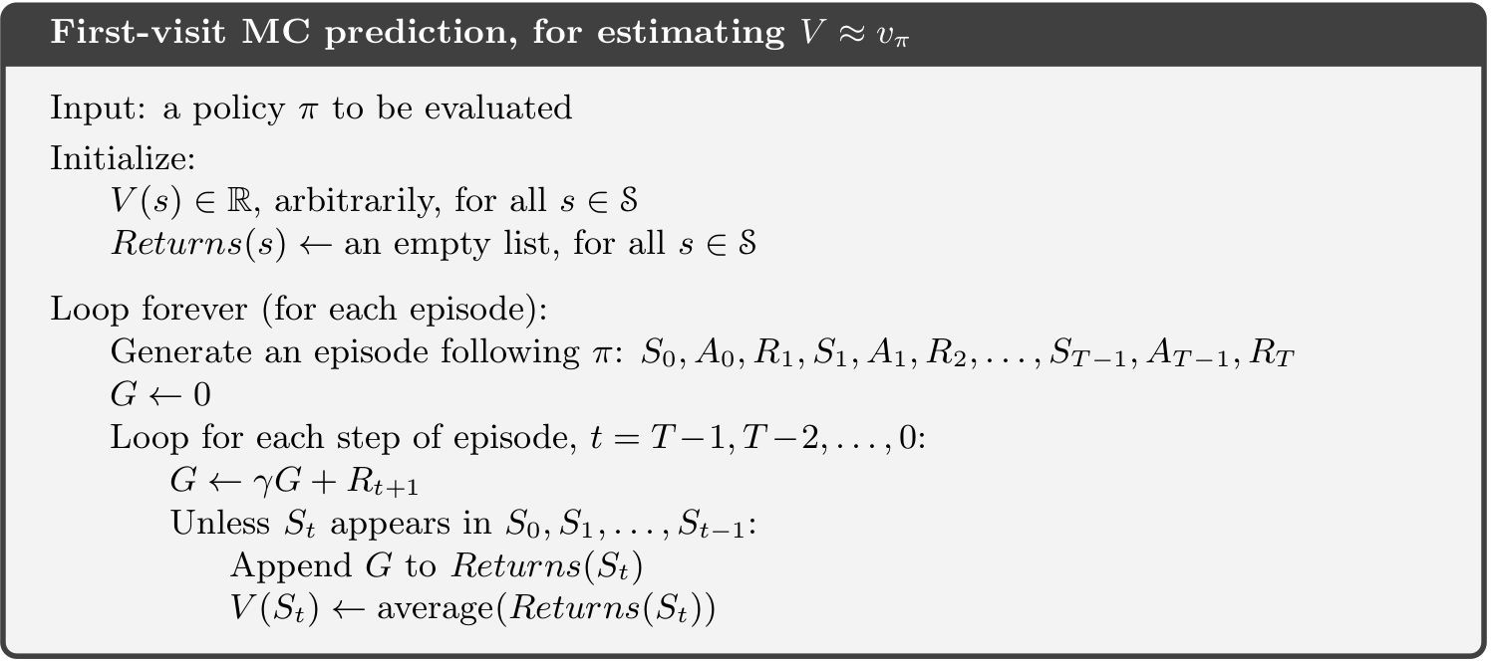
First-visit MC prediction in Practice:

Slide 6

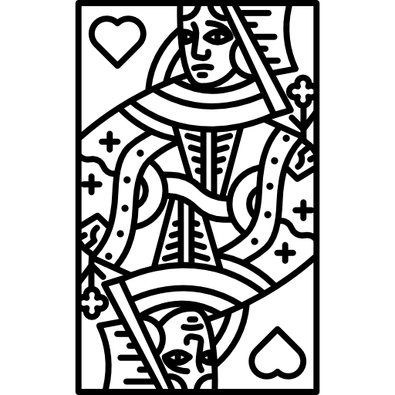
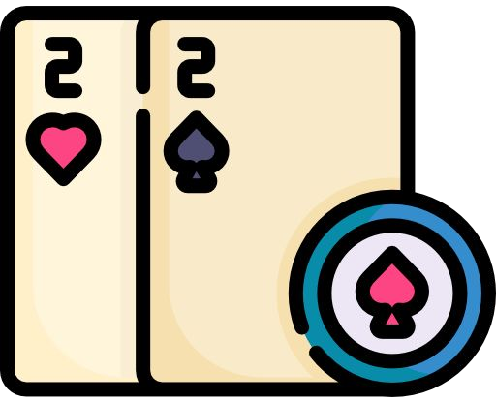
Blackjack Example
States: (Sum of cards, Has usable ace, Dealer’s card)
Action: Hit (request card), Stick (stop)
Reward: +1, 0, -1 for win, draw, loss
Policy: request cards if and only if sum < 20
Difficult to use DP although environment dynamics is known

Slide 7
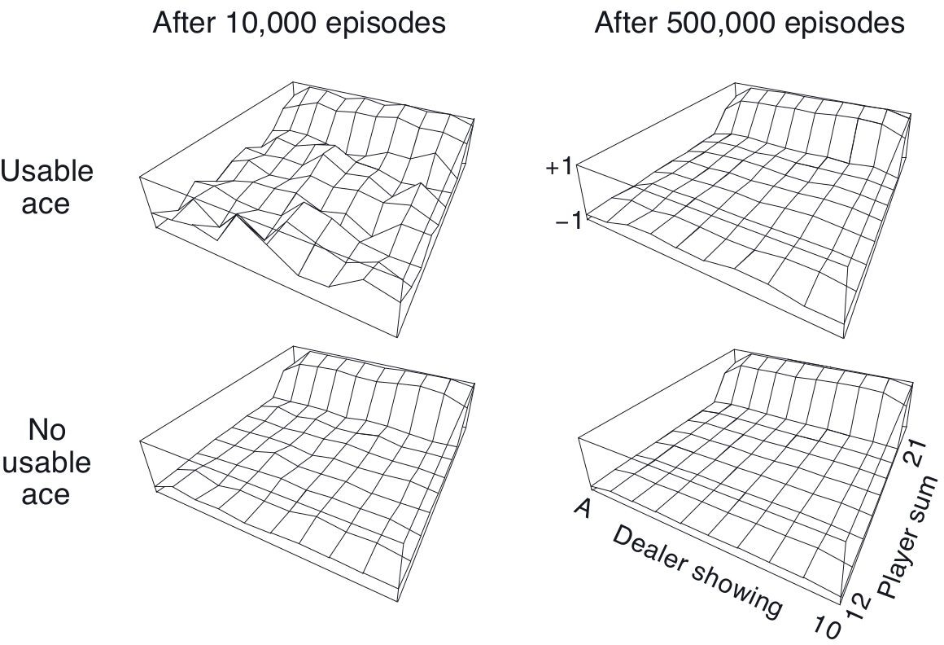
Blackjack Example Results
Less common experience have uncertain estimates
ex) States with usable ace

Slide 8
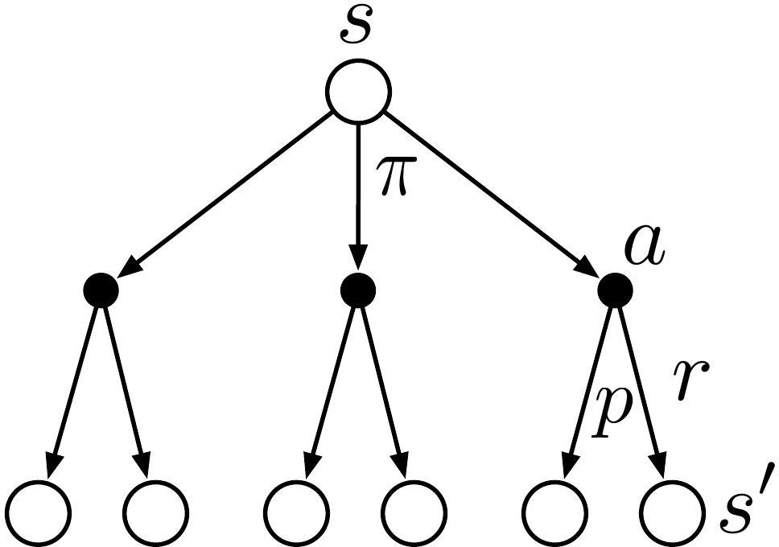
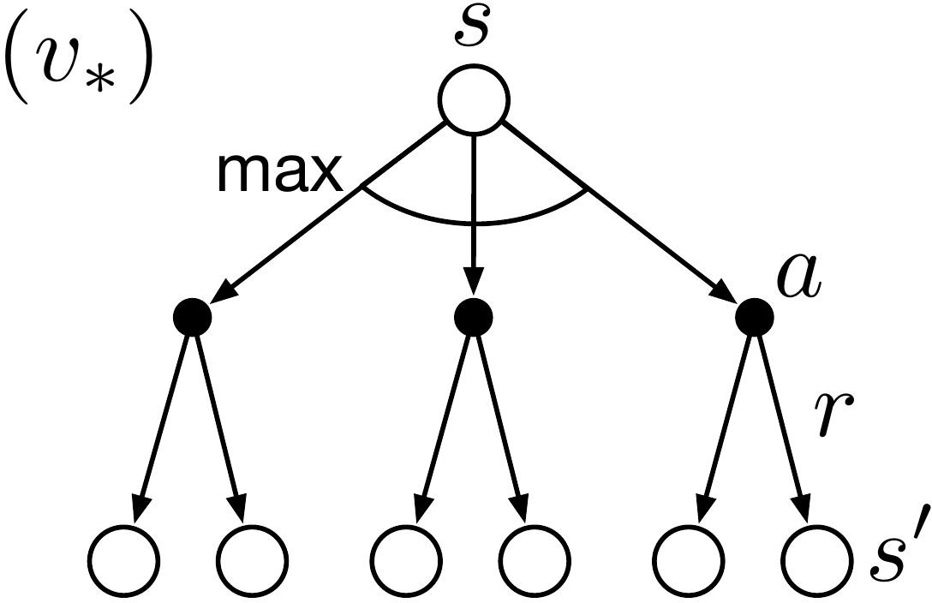
MC vs. DP
No bootstrapping
Estimates for each state are independent
Can estimate the value of a subset of all states
Monte Carlo
Dynamic Programming

Slide 9
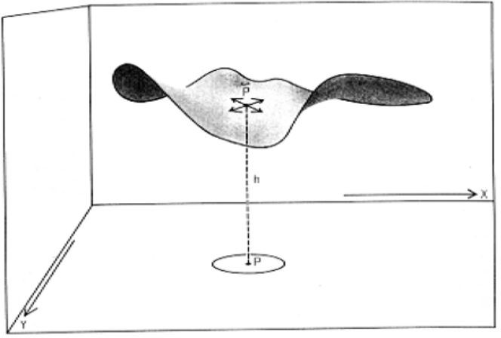
Soap Bubble Example
Compute shape of soap surface for a closed wire frame
Height of surface is average of heights at neighboring points
Surface must meet boundaries with the wire frame

Slide 10
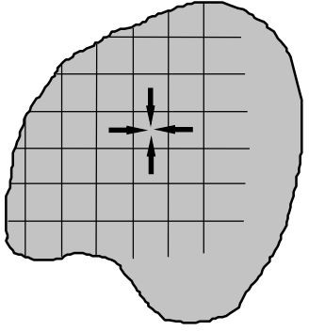
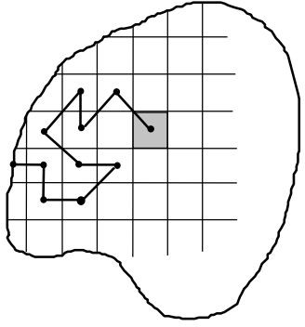
Soap Bubble Example: DP vs. MC
DP
MC
Update heights by its neighboring heights
Iteratively sweep the grid
Take random walk until boundary is reached
Average sampled boundary height
http://www-anw.cs.umass.edu/~barto/courses/cs687/Chapter%205.pdf

Slide 11
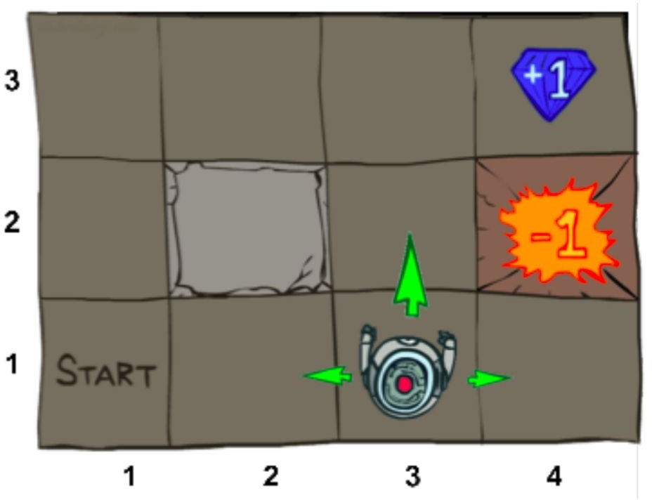
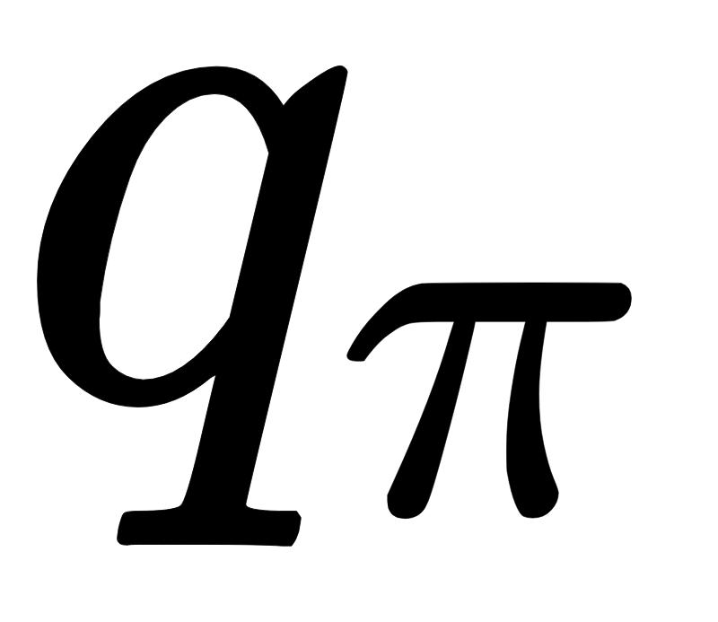
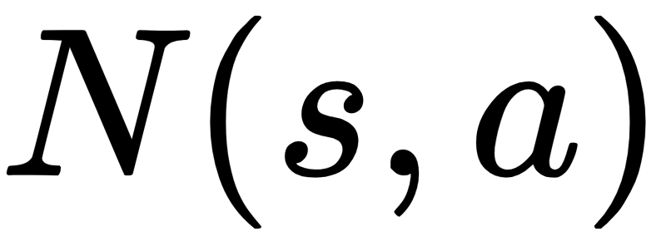
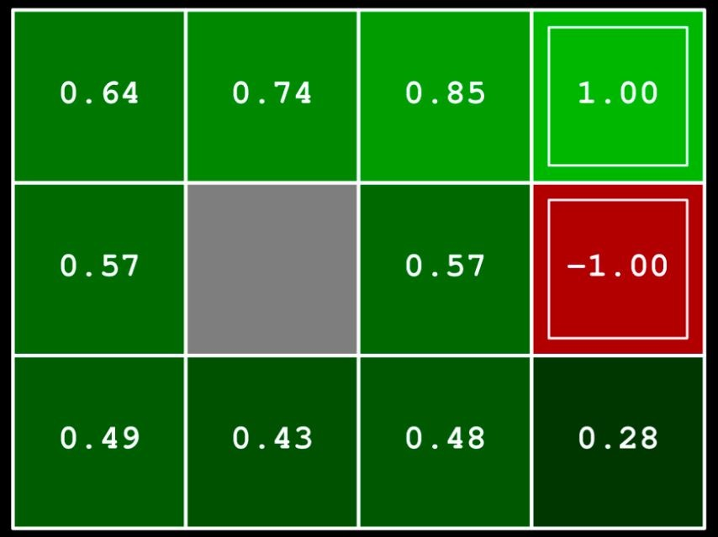
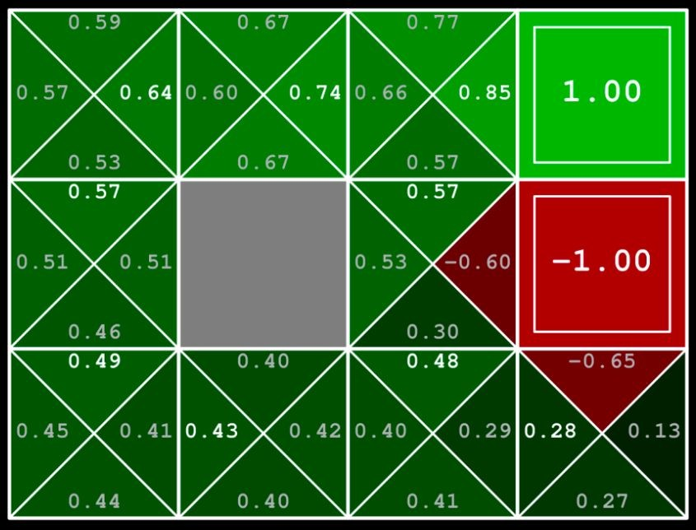
Monte Carlo Prediction:
More useful if model is not available
Can determine policy without model
Converges quadratically to when infinite samples
Need exploration: all state-action pairs need to be visited infinitely
https://www.youtube.com/watch?v=qaMdN6LS9rA

Slide 12
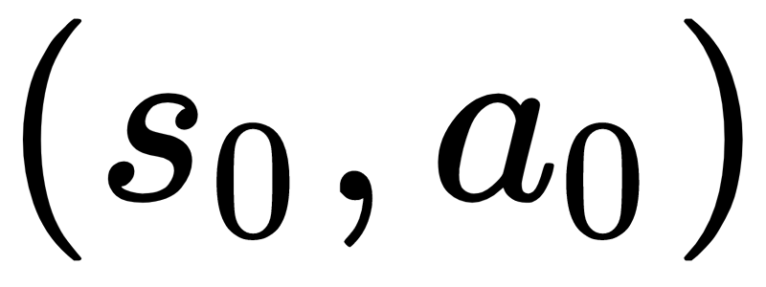
Exploring Starts (ES)
Specify state-action pair to start episode on
Cannot be used when learning from actual interactions

Slide 13
Monte Carlo ES
Control: approximate optimal policies
Use Generalized Policy Iteration (GPI)
Maintain approximate policy and approximate value function
Policy evaluation: Monte Carlo Prediction for one episode with start chosen by ES
Policy Improvement: Greedy selection\
No proof of convergence

Slide 14
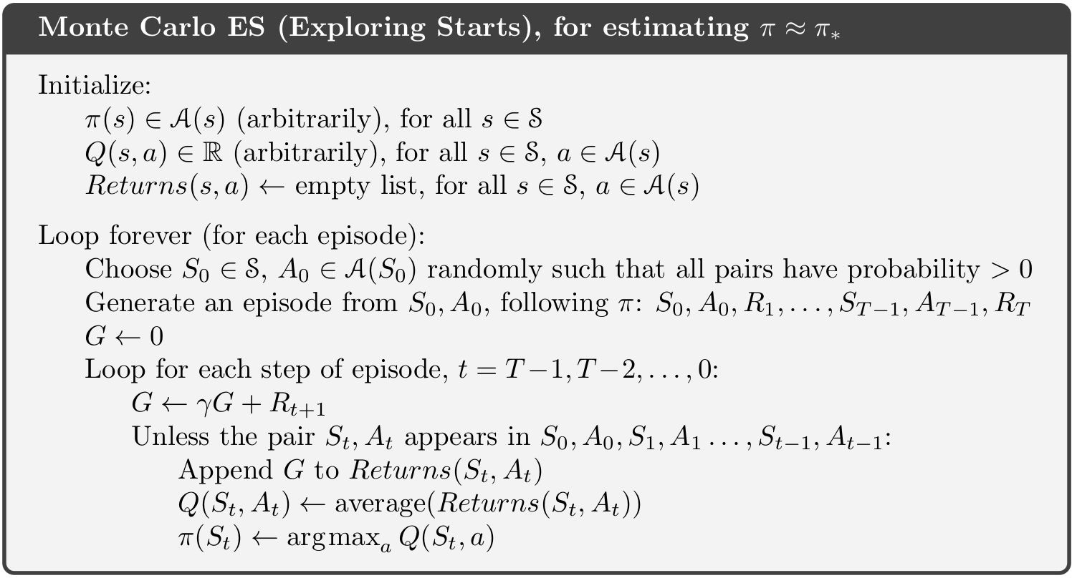
Monte Carlo ES Pseudocode

Slide 15
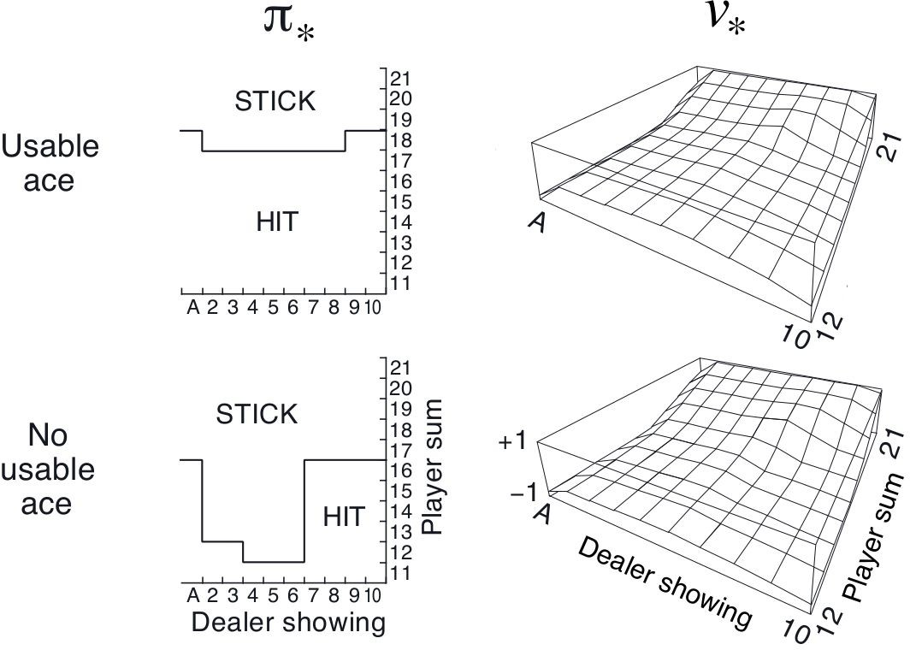
Blackjack Example Revisited
Prediction → Control

Slide 16
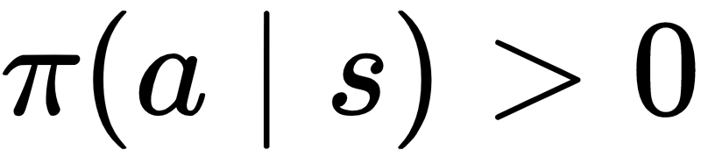
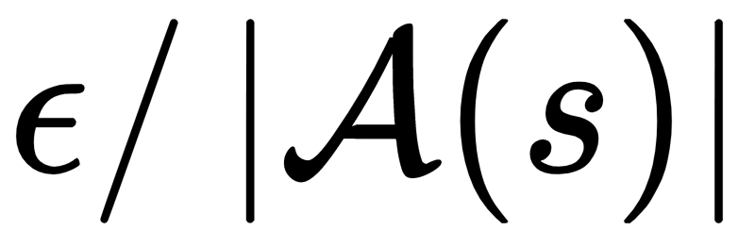
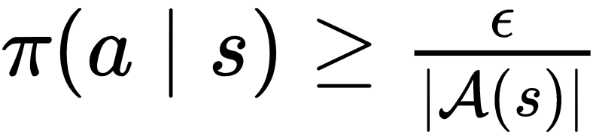
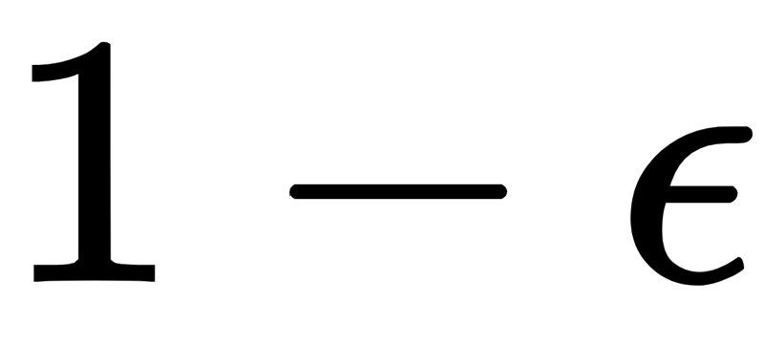
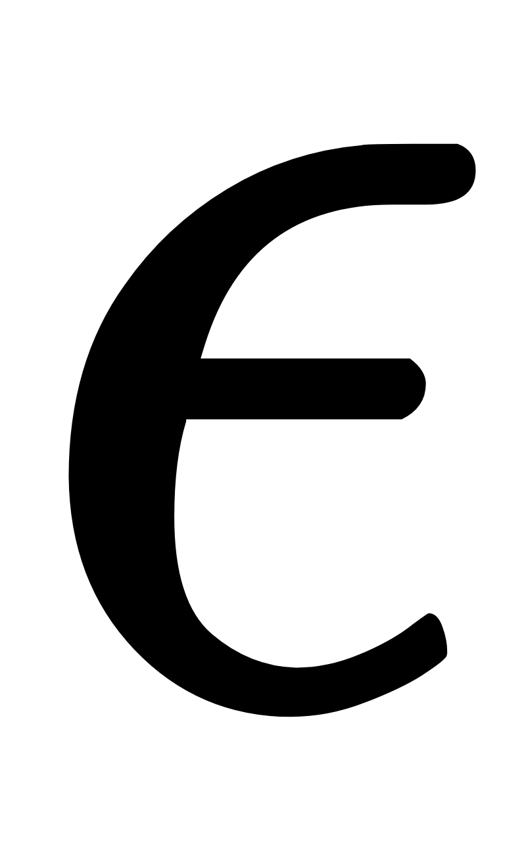
ε-soft Policy
Avoid exploring starts → Add exploration to policy
Soft policy: every action has nonzero probability of being selected
ε-soft policy: every action has at least
probability of being selected
ex) ε-greedy policy
Select greedily for probability
Select randomly for probability (including greedy)

Slide 17

ε-soft vs ε-greedy
ε-soft ε = 0.1
ε-greedy ε = 0.1
Random ε = 1
Greedy ε = 0
Softer

Slide 18
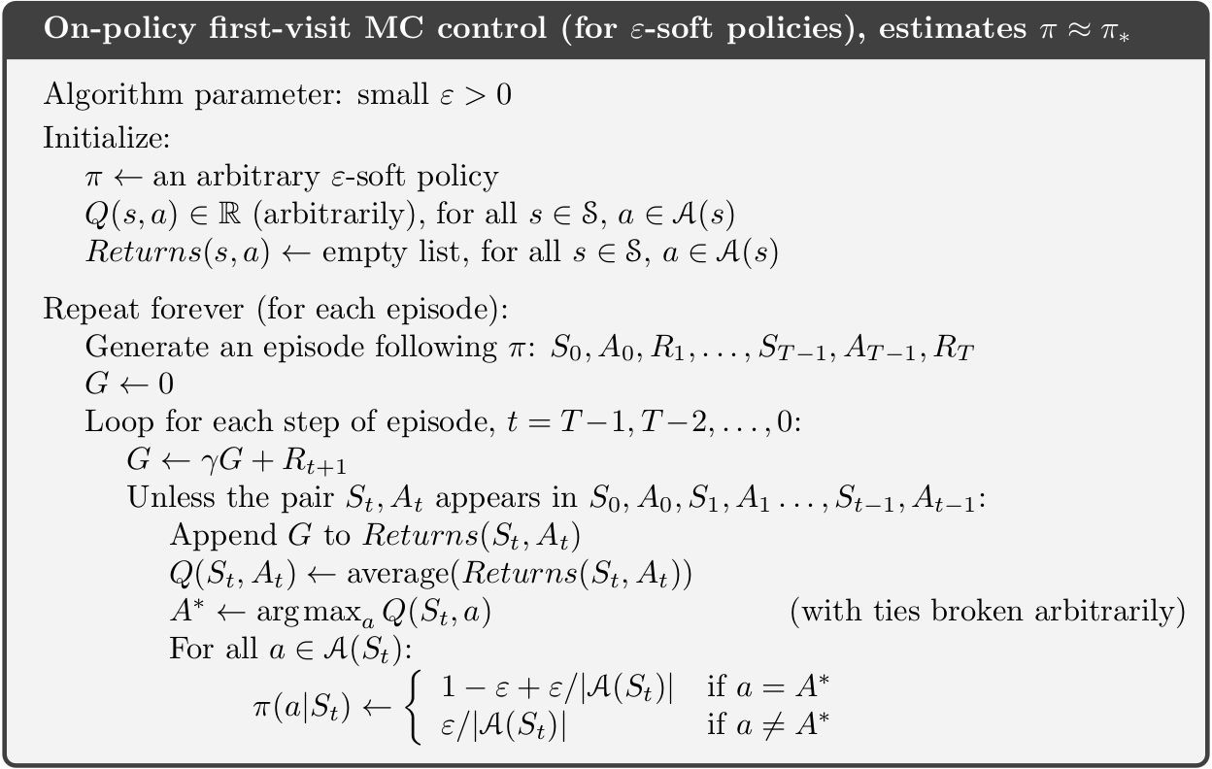
On-policy ε-soft MC control Pseudocode
On-policy: Evaluate / improve policy that is used to make decisions

Slide 19
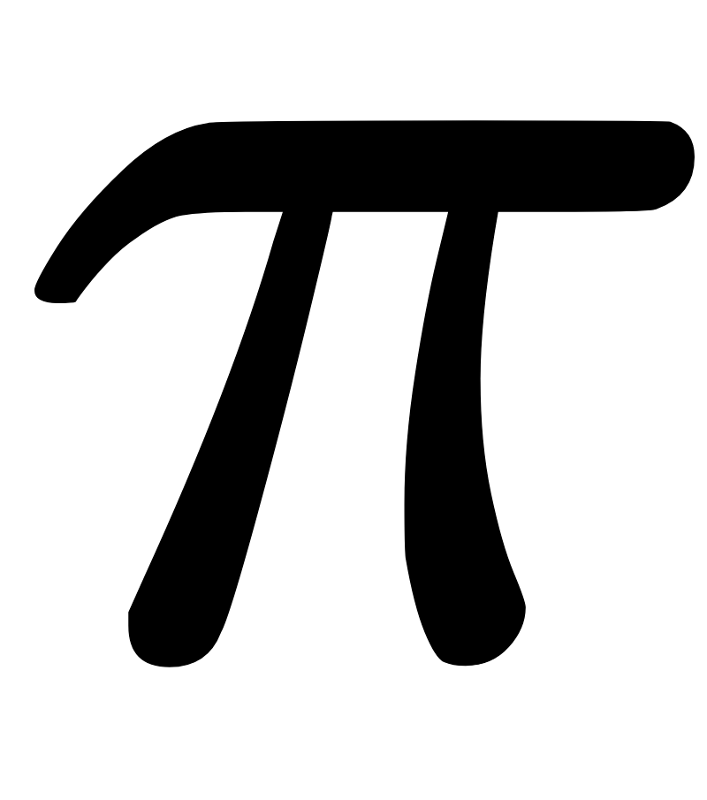
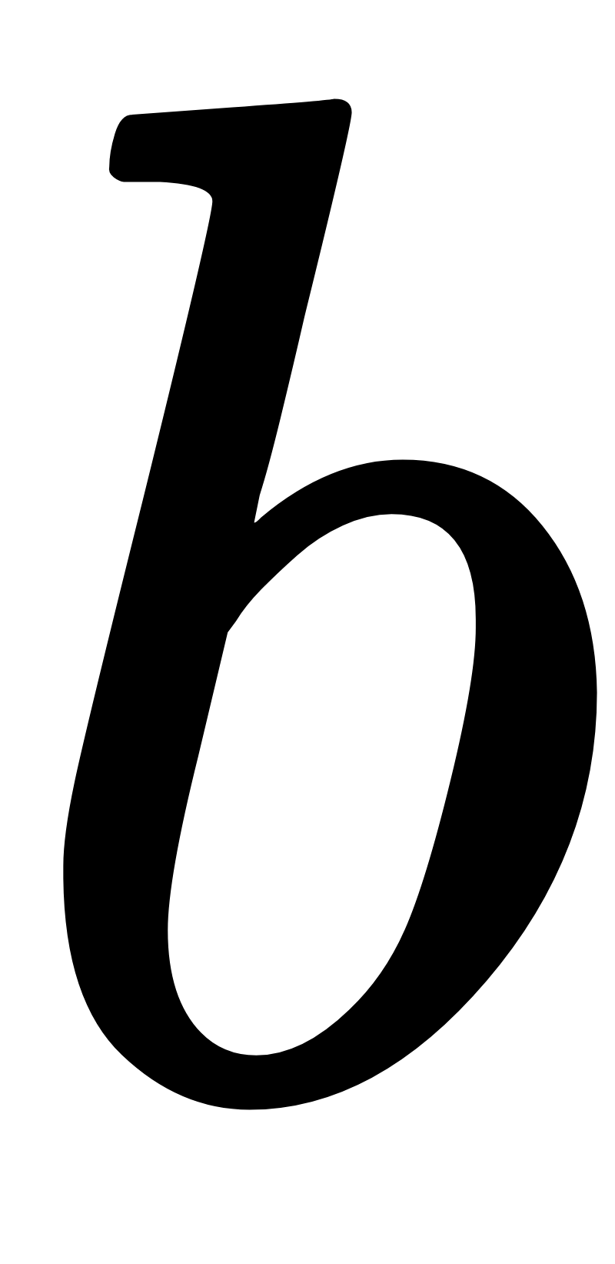
On-policy vs. Off-policy
On-policy: Evaluate / improve policy that is used to make decisions
Requires ε-soft policy: near optimal but never optimal
Simple, low variance
Off-policy: Evaluate / improve policy different from that used to generate data
Target policy : policy to evaluate
Behavior policy : policy for taking actions
More powerful and general
High variance, slower convergence
Can learn from non-learning controller or human expert

Slide 20

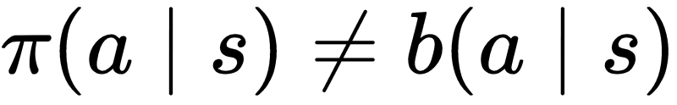
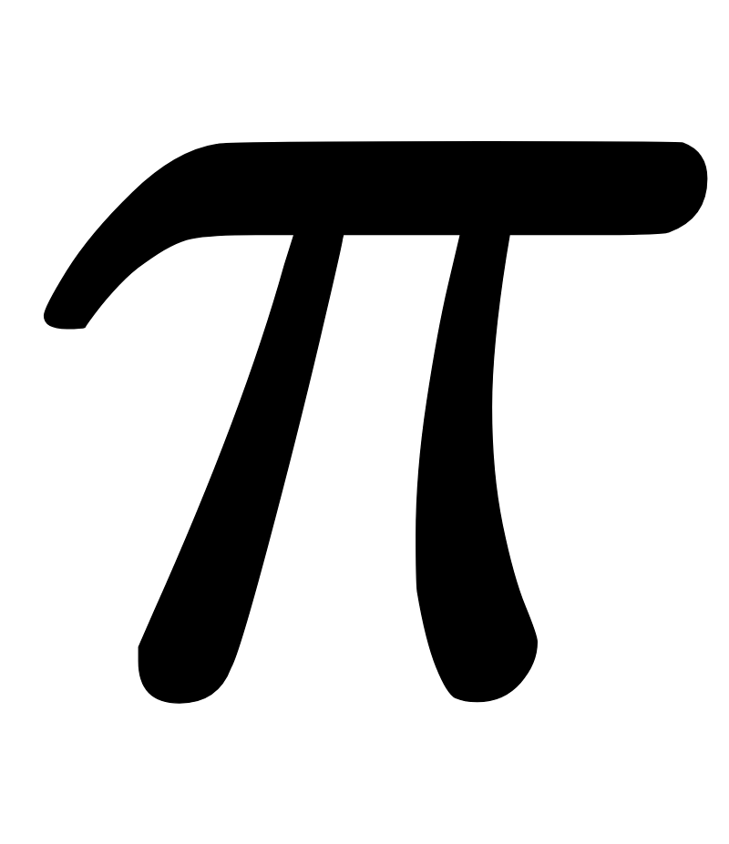
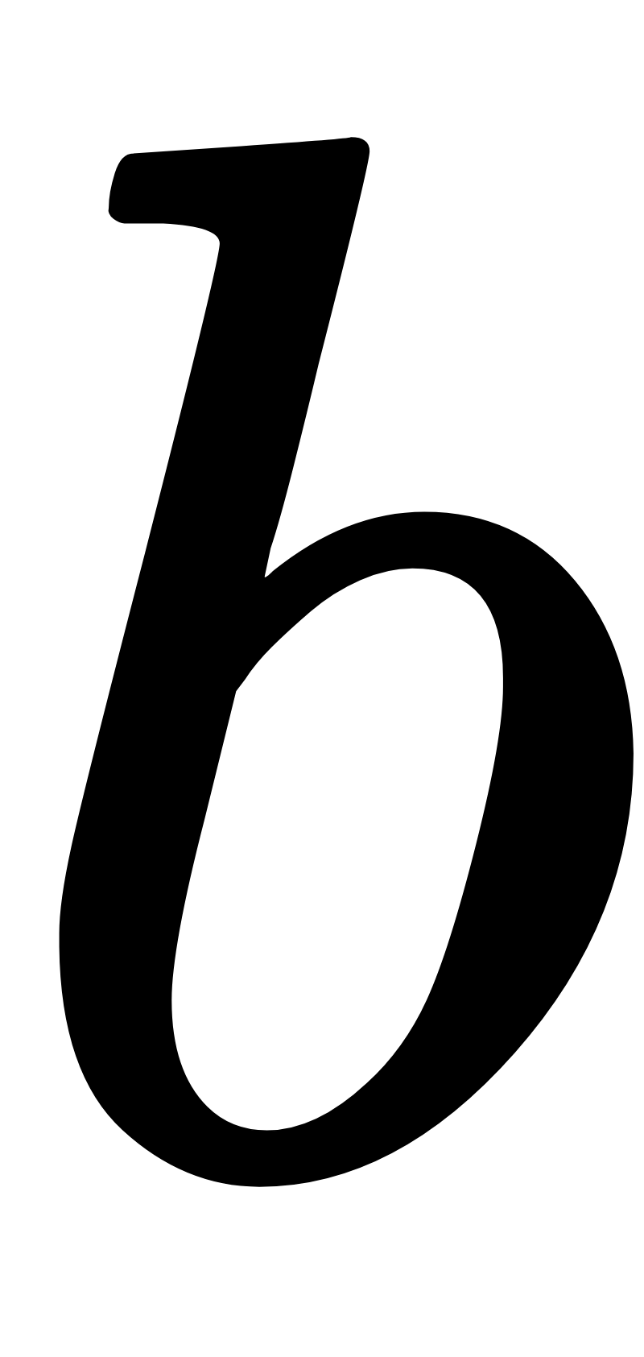
Coverage assumption for off-policy learning
To estimate values under , all possible actions of must be taken by
must be stochastic in states where

Slide 21
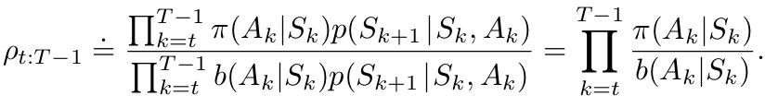
Importance Sampling
Trajectories have different probabilities under different policies
Estimate expected value from one distribution given samples from another
Weight returns by importance sampling ratio
Relative probability of trajectory occurring under the target and behavior policies

Slide 22
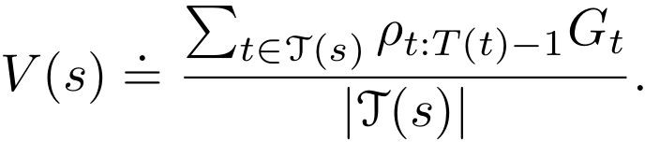
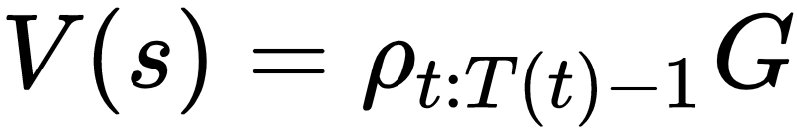
Ordinary Importance Sampling
Zero bias but unbounded variance
With single return:

Slide 23
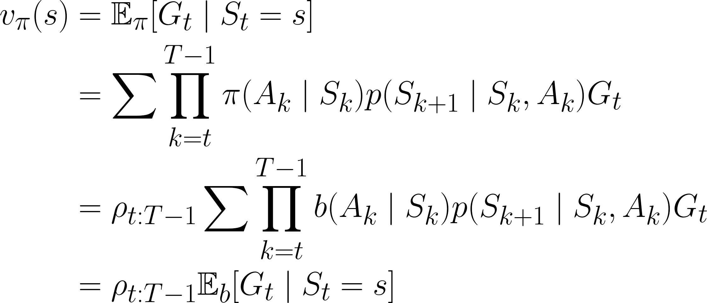
Ordinary Importance Sampling: Zero Bias

Slide 24
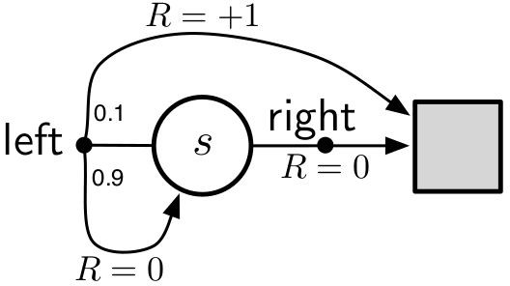
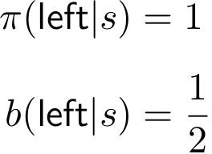
Ordinary Importance Sampling: Unbounded Variance
1-state, 2-action undiscounted MDP
Off-policy first-visit MC
Variance of an estimator:

Slide 25
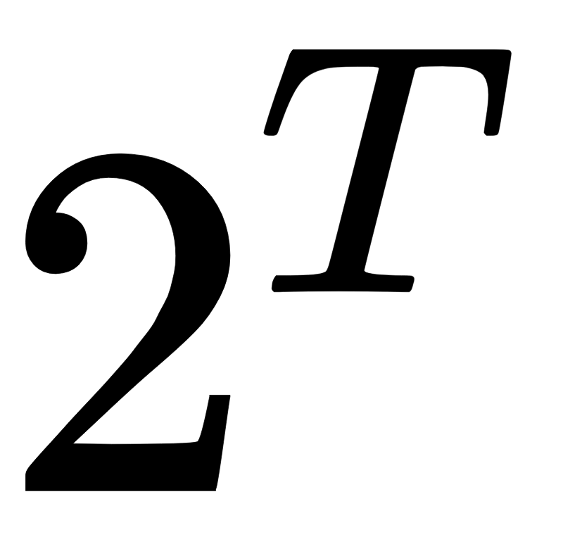
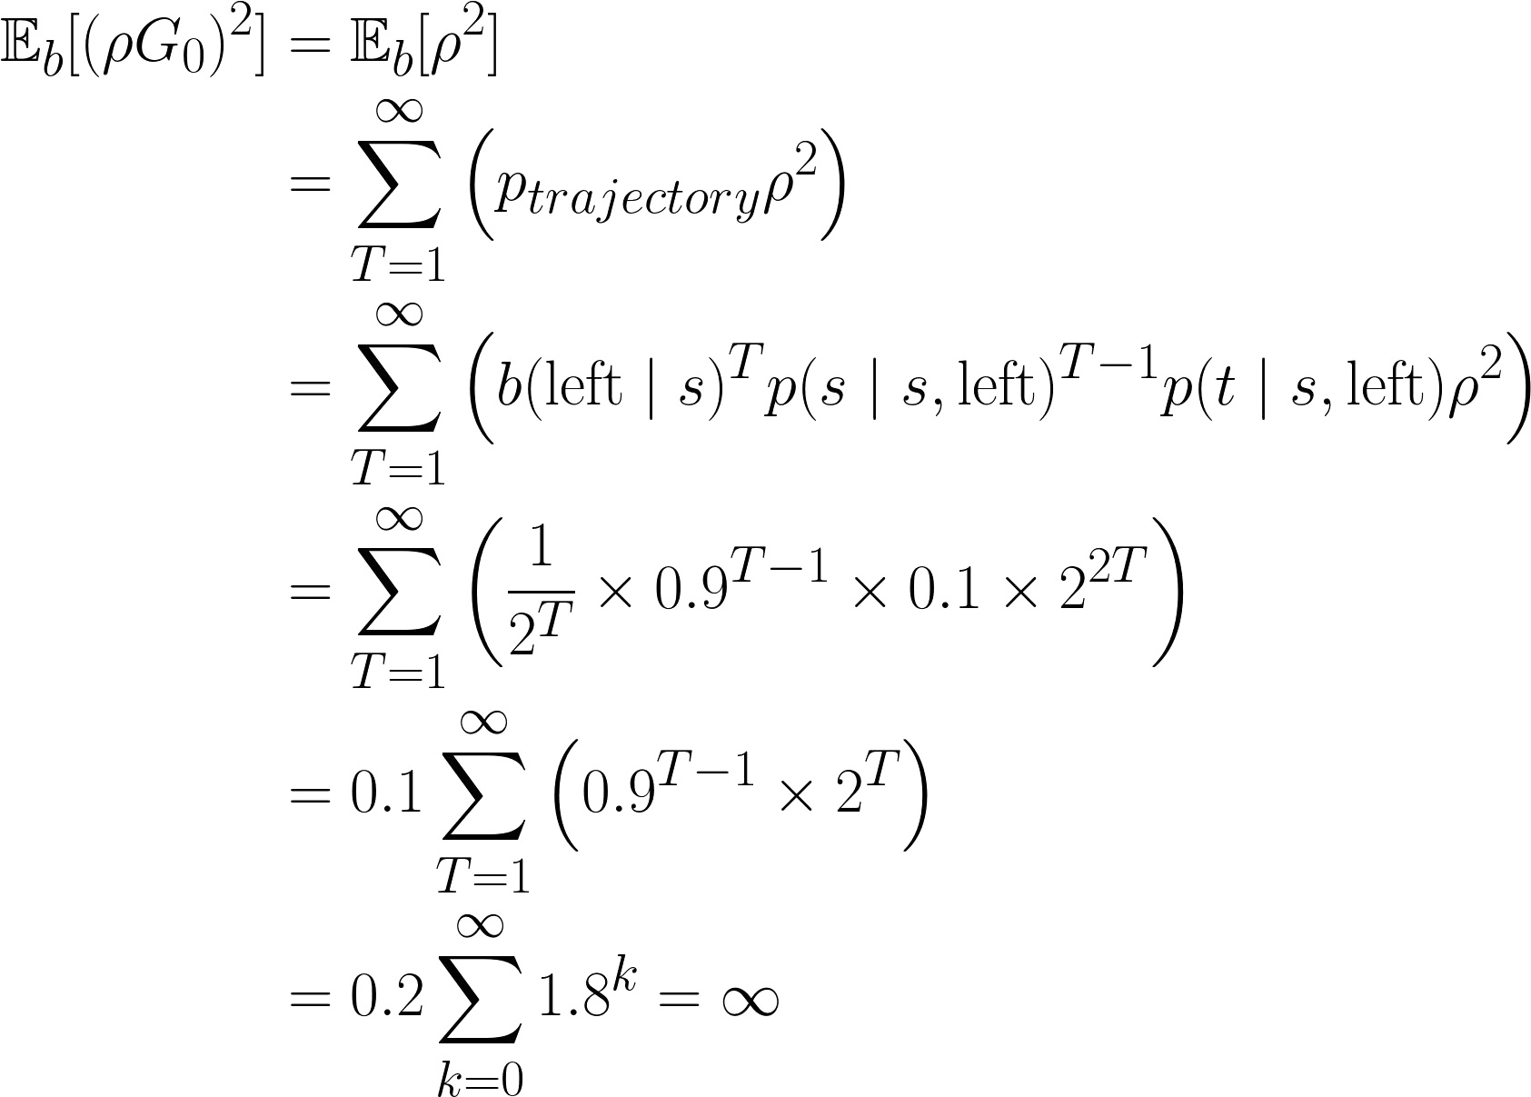
Ordinary Importance Sampling: Unbounded Variance
Just consider all-left episodes with different lengths
Any trajectory with right has importance sampling ratio of 0
All-left trajectory have importance sampling ratio of

Slide 26
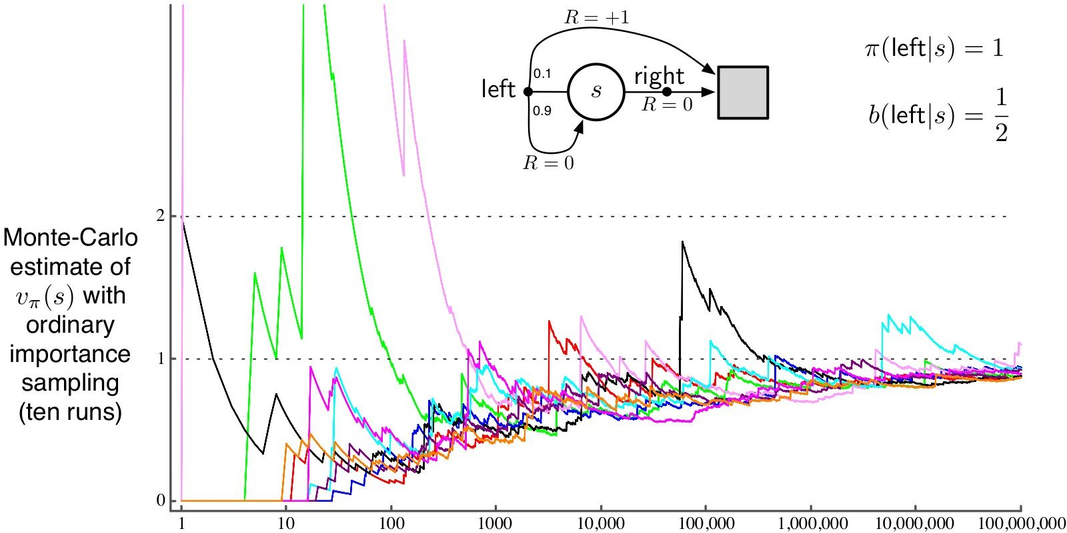
Ordinary Importance Sampling: Unbounded
Vari
ance

Slide 27
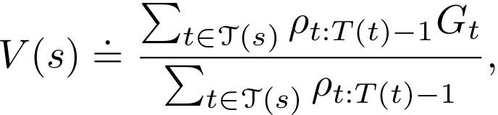
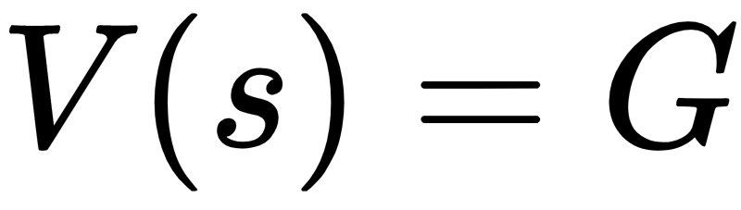
Weighted Importance Sampling
Has bias that converges asymptotically to zero
Strongly preferred due to lower variance
With single return:

Slide 28
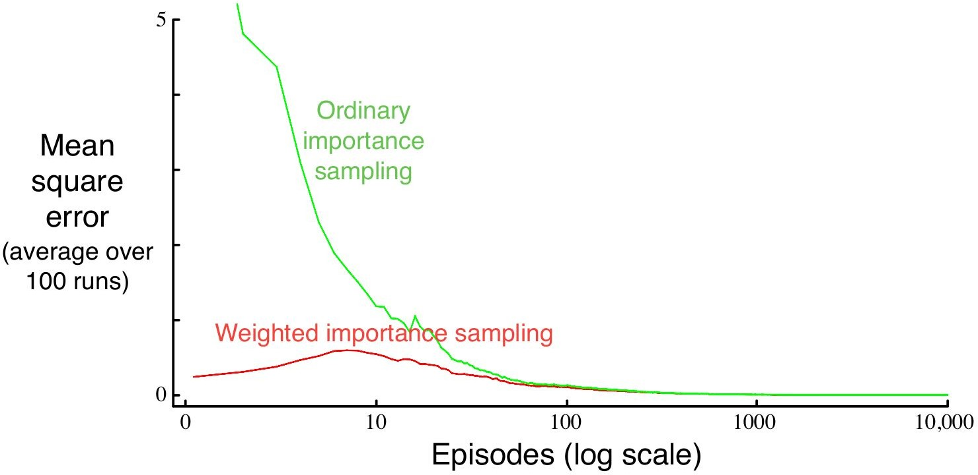
Blackjack example for Importance Sampling
Evaluated for a single state
player’s sum = 13, has usable ace, dealer’s card = 2
Behavior policy: uniform random policy
Target policy: stick iff player’s sum >= 20

Slide 29
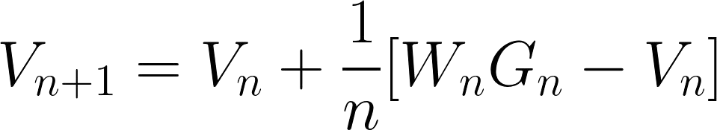
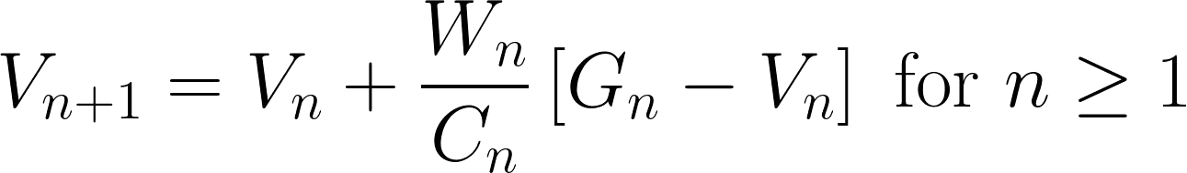

Incremental Monte Carlo
Update value without tracking all returns
Ordinary importance sampling:
Weighted importance sampling:

Slide 30
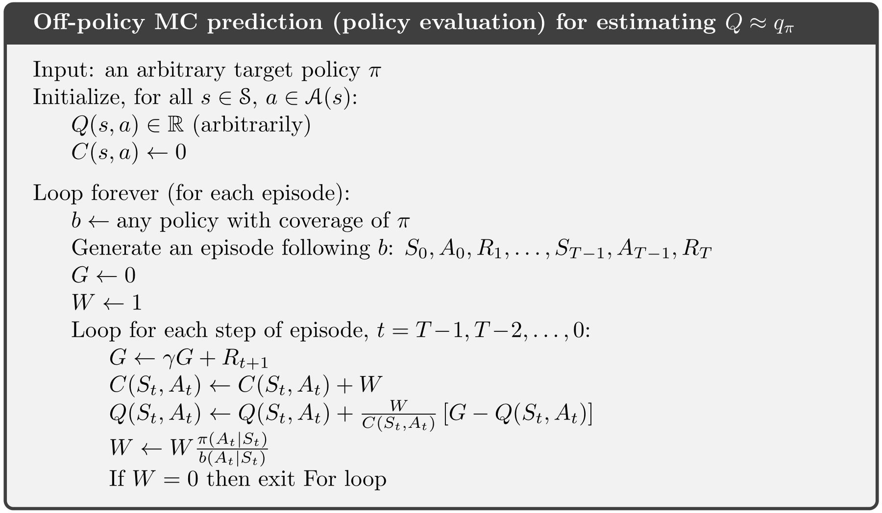
Incremental Monte Carlo Pseudocode

Slide 31
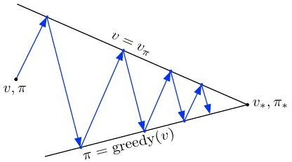


Off-policy Monte Carlo Control
Off-policy: target policy and behavior policy
Monte Carlo: Learn from samples without bootstrapping
Control: Find optimal policy through GPI

Slide 32
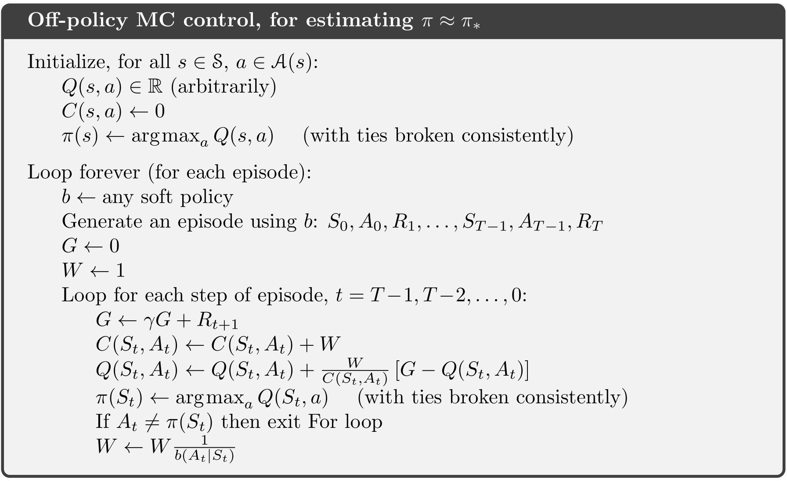
Off-policy Monte Carlo Control Pseudocode

Slide 33
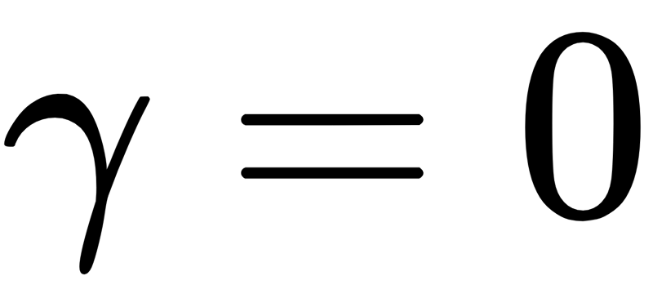

Discounting-aware Importance Sampling: Intuition*
Exploit return’s internal structure to reduce variance
Return = Discounted sum of rewards
Consider myopic discount
Irrelevant to return: adds variance

Slide 34
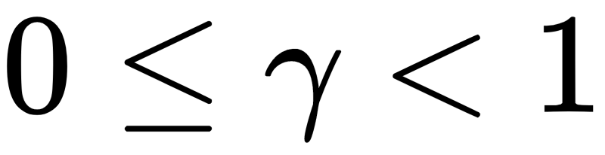
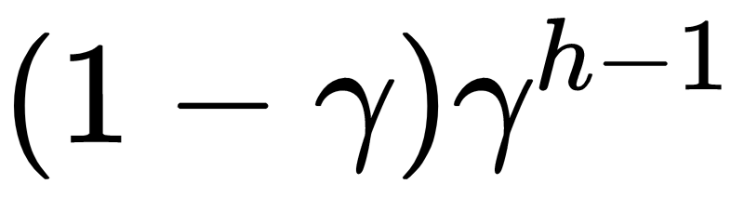
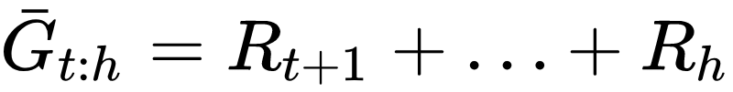

Discounting as Partial Termination*
Consider discount as degree of partial termination
If
If
Premature termination results in partial returns
, all episodes terminate after receiving first reward
, episode could terminate after n steps with probability
Full Return as flat (undiscounted) partial return

Slide 35

Discounting-aware Ordinary Importance Sampling*
Scale flat partial returns by a truncated importance sampling ratio
Estimator for Ordinary importance sampling:
Estimator for Discounting-aware ordinary importance sampling

Slide 36


Discounting-aware Weighted Importance Sampling*
Scale flat partial returns by a truncated importance sampling ratio
Estimator for Weighted importance sampling
Estimator for Discounting-aware weighted importance sampling

Slide 37


Per-decision Importance Sampling: Intuition*
Unroll returns as sum of rewards
Can ignore trajectory after the reward since they are uncorrelated

Slide 38

Per-decision Importance Sampling: Process*
Simplify expectation
Equivalent expectation for return

Slide 39

Per-decision Ordinary Importance Sampling*
Estimator for Ordinary Importance Sampling:
Estimator for Per-reward Ordinary Importance Sampling:

Slide 40
Per-decision Weighted Importance Sampling?*
Unclear if per-reward weighted importance sampling is possible
All proposed estimators are inconsistent
Do not converge asymptotically

Slide 41
Summary
Learn from experience (sample episodes)
Learn directly from interaction without model
Can learn with simulation
Can focus to subset of states
No bootstrapping → less harmed by violation of Markov property
Need to maintain exploration for Control
Exploring starts: unlikely in learning from real experience
On-policy: maintain exploration in policy
Off-policy: separate behavior and target policies
Importance Sampling
Ordinary importance sampling
Weighted importance sampling

Slide 42
References
Reinforcement Learning: An Introduction by Sutton and Barto
Reinforcement-learning-an-introduction-chapter-5

